Slide 1
PREDICTIVE MODELING OF DIABETES WITH CLASSIFICATION ALGORITHM
Final Project
Group 4
Balajigowda H S,
Lily Huang,
Bernie Ridgeway,
Yidi Wu

Slide 2
A Data-Driven Analysis on Diabetes
Diabetes is a chronic disease that occurs either when the pancreas does not produce enough insulin or when the body cannot effectively use the insulin it produces.
Insulin is a hormone that regulates blood glucose. Hyperglycemia, also called raised blood glucose or raised blood sugar, is a common effect of uncontrolled diabetes and over time leads to serious damage to many of the body's systems, especially the nerves and blood vessels.
Diabetes is a major cause of blindness, kidney failure, heart attacks, stroke and lower limb amputation.
According to a report from the World Health Organization, 1.5 million deaths are directly attributed to diabetes each year.
From the dataset, the main objective is to identify the most significant factors in the onset of diabetes with the goal being prevention.

Slide 3
Introduction
Diabetes is currently one of the most common and prevalent chronic diseases, leading over time to serious damage to the heart, blood vessels, eyes, kidneys, and nerves. (WHO,2023)According to the World Health Organization (WHO) report, there are 1.5 million deaths directly attributed to diabetes each year.(WHO,2023) With changes in lifestyle and dietary habits, an increasing number of people are affected by this disease. Through data analysis, our aim is to identify the most significant factors contributing to the onset of diabetes with the goal of prevention. This dataset originates from the National Institute of Diabetes and Digestive and Kidney Diseases. Based on this data, we focus on BMI, blood glucose levels, and age, hoping to uncover their associations with diabetes. We will utilize different ML models and choose the best performing model to analyze the relationship among various factors and discover preventive strategies to reduce the future incidence of diabetes.

Slide 4
Dataset
Pregnancies: Number of times pregnant
Glucose: Plasma glucose concentration a 2 hours in an oral glucose tolerance test
BloodPressure: Diastolic blood pressure (mm Hg)
SkinThickness: Triceps skin fold thickness (mm)
Insulin: 2-Hour serum insulin (mu U/ml)
BMI: Body mass index (weight in kg/(height in m)^2)
DiabetesPedigreeFunction: Diabetes pedigree function
Age: Age (years)
Outcome: Class variable (0 or 1)

Slide 5
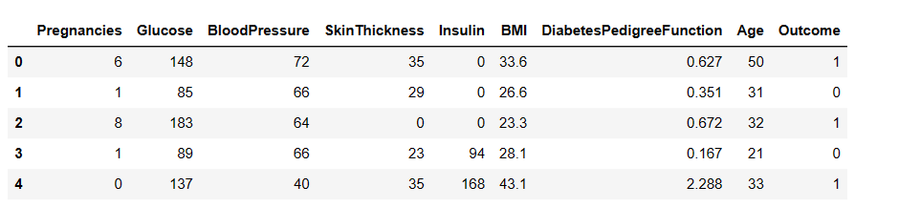
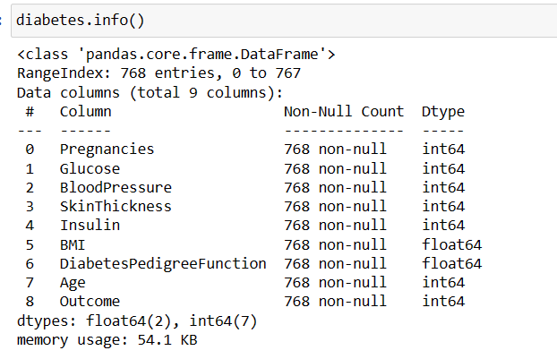
Dataset--Descriptive

Slide 6
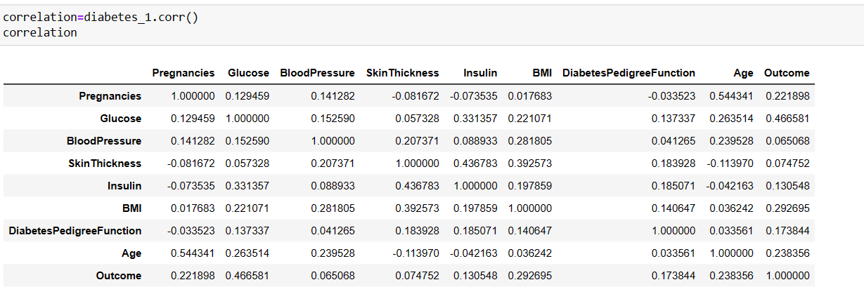
Correlation

Slide 7
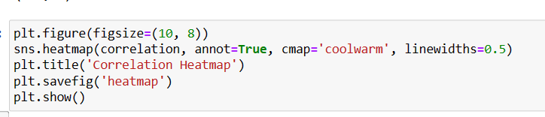
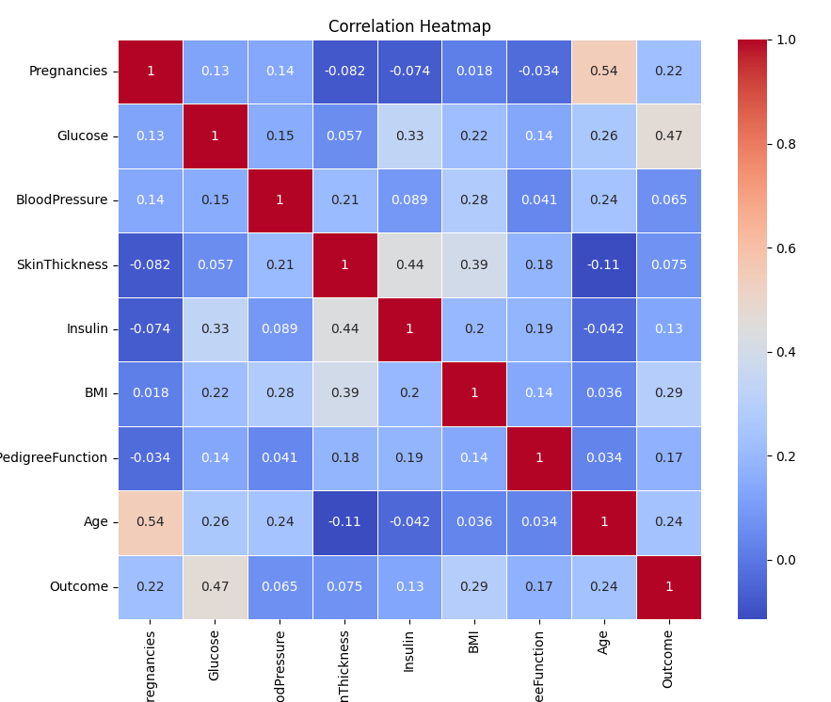
Correlation Heatmap

Slide 8
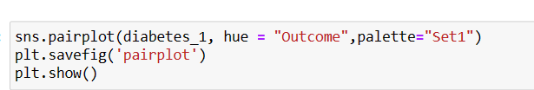
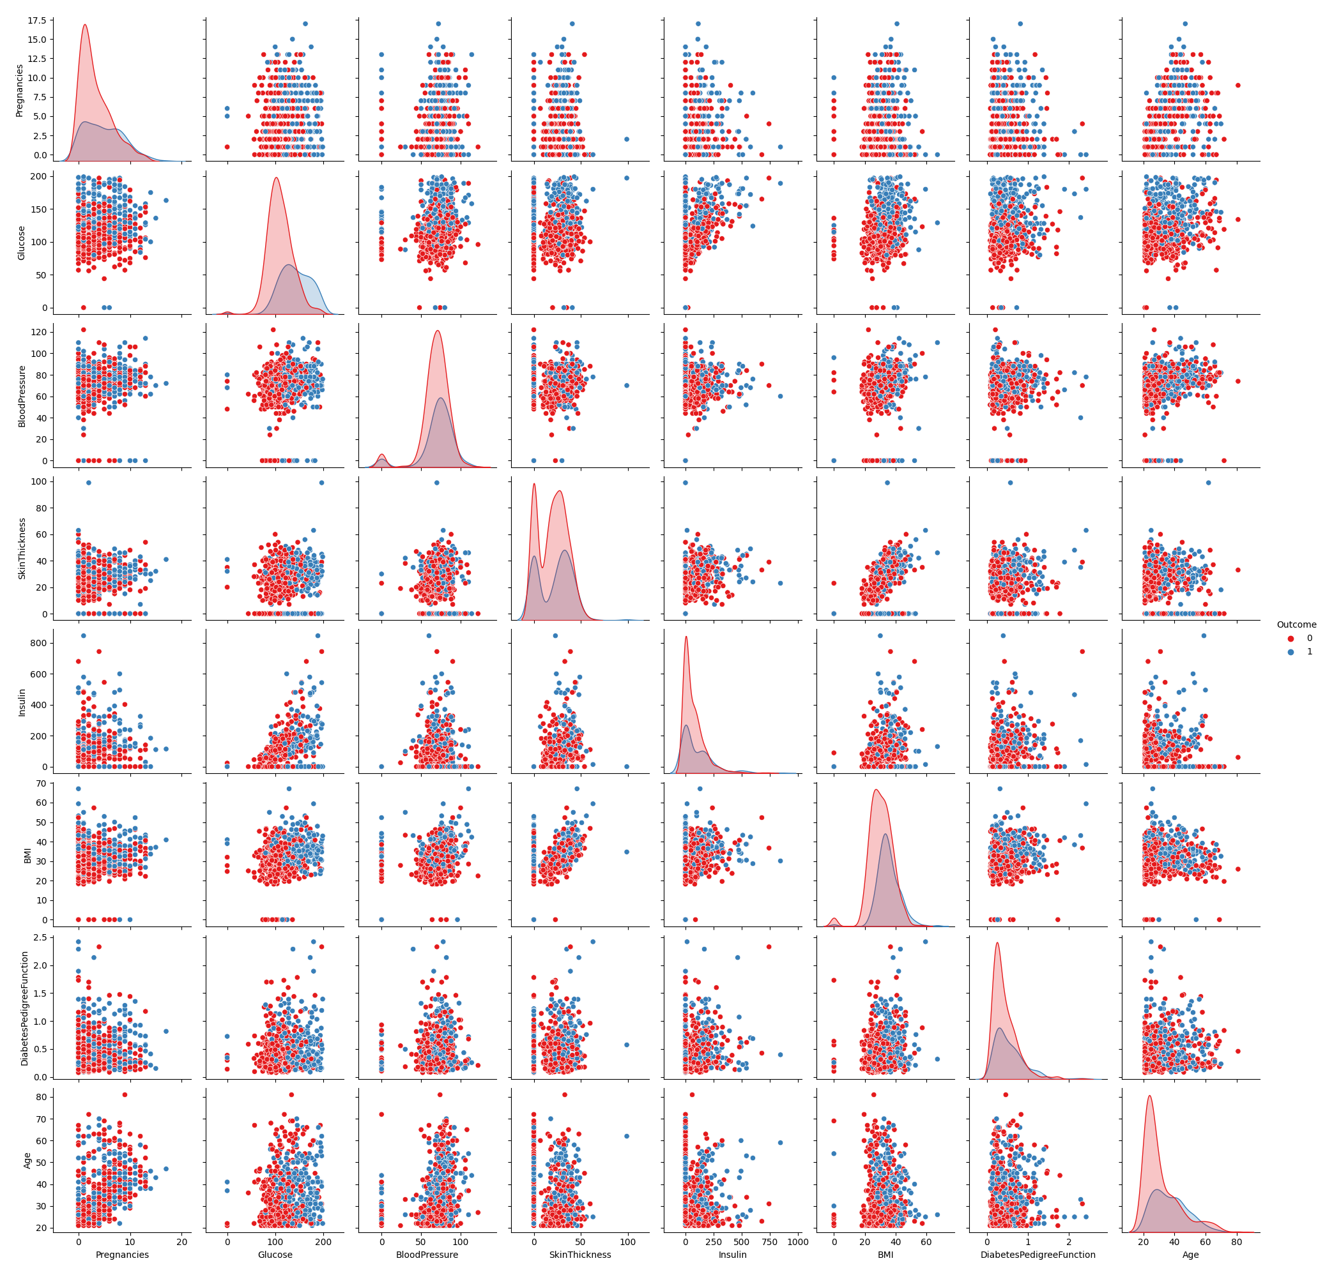
Pair Plot

Slide 9
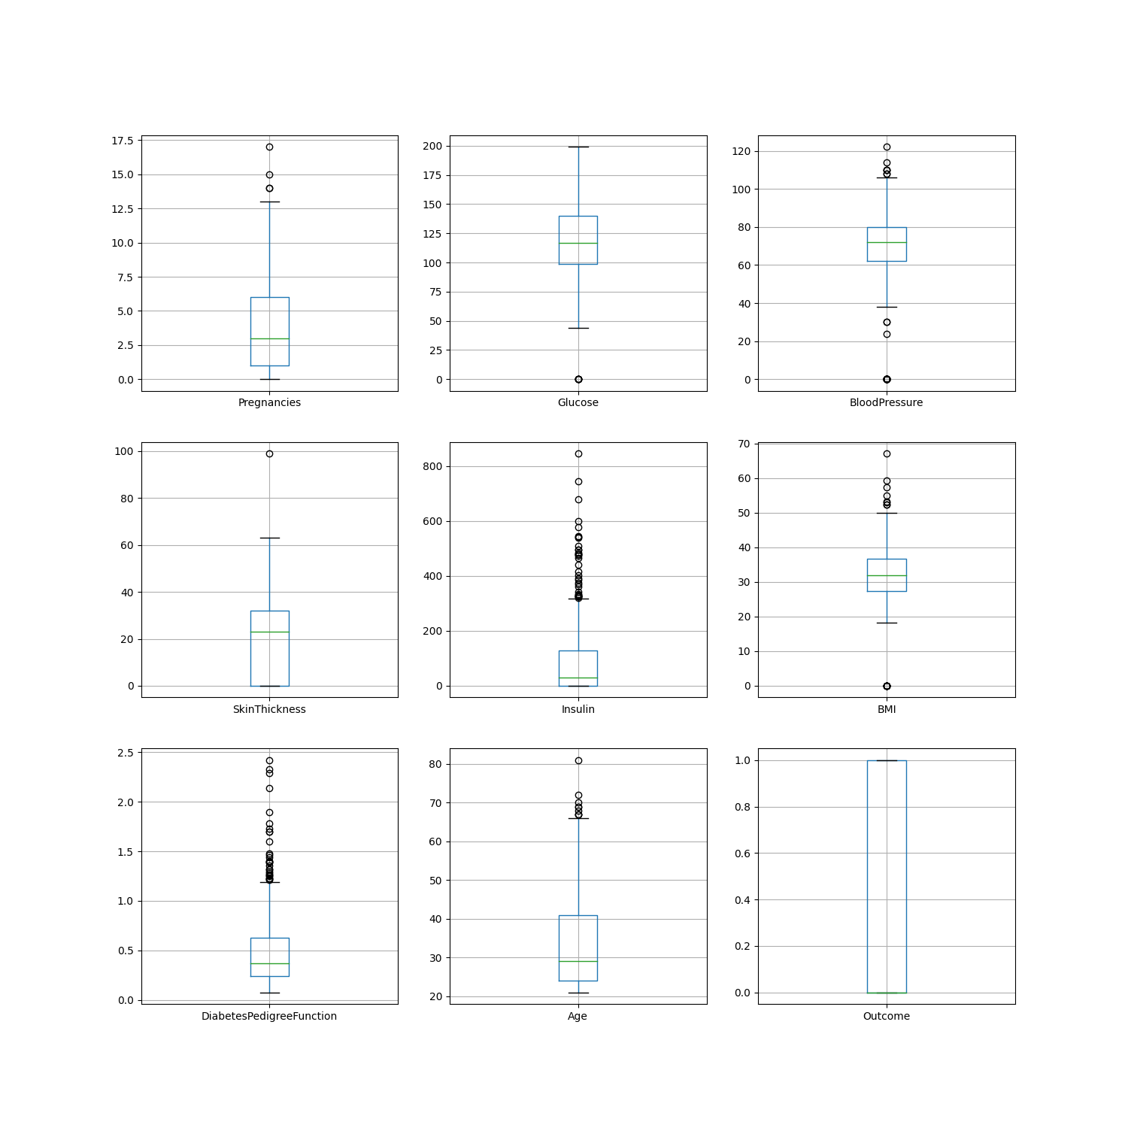
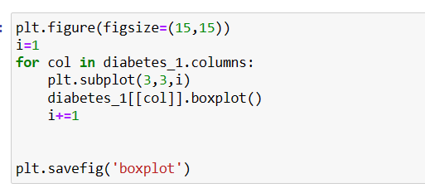
Boxplot

Slide 10
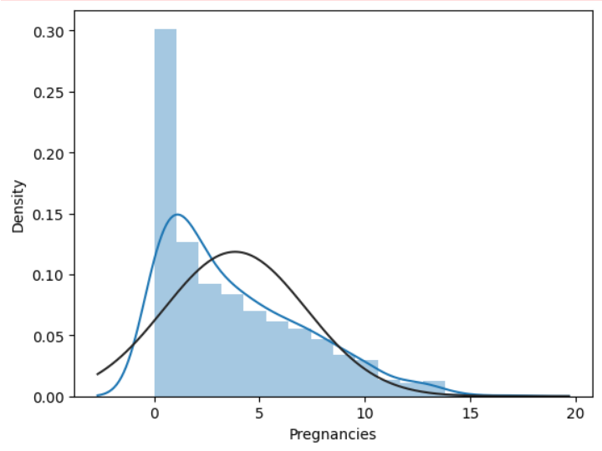
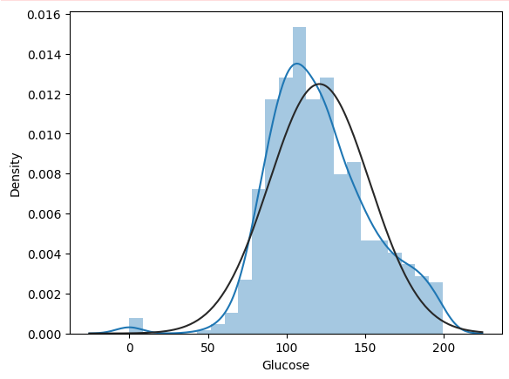
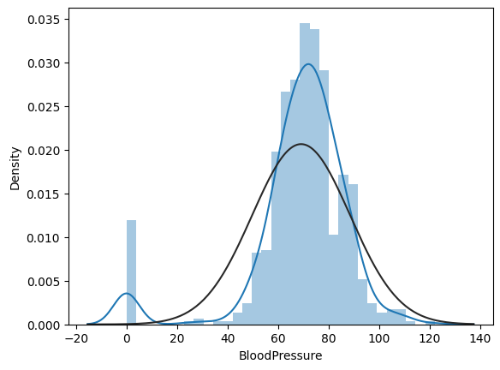
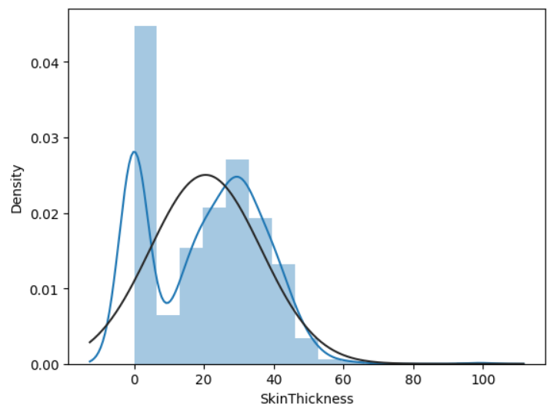
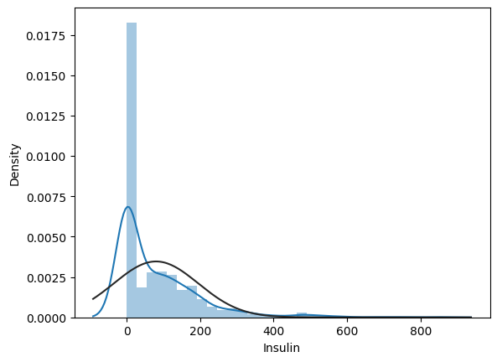
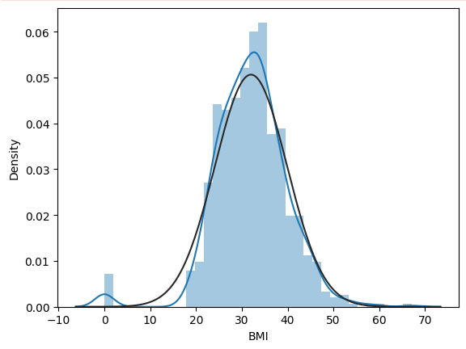
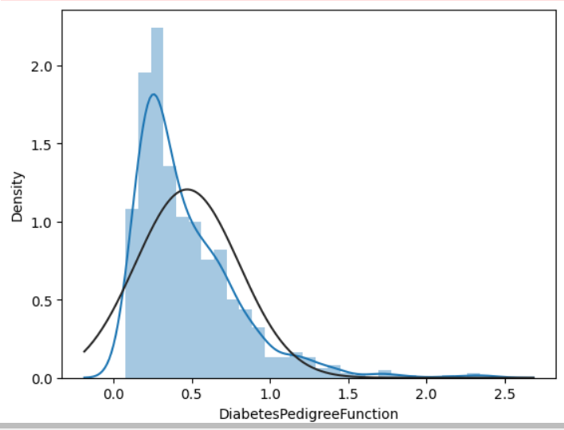
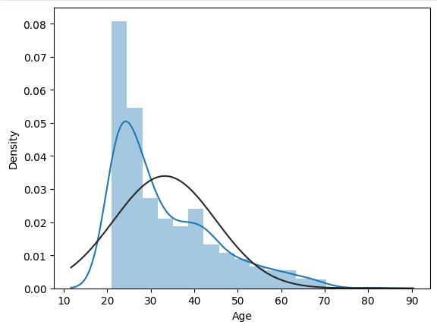
Variable Distribution-Histogram

Slide 11
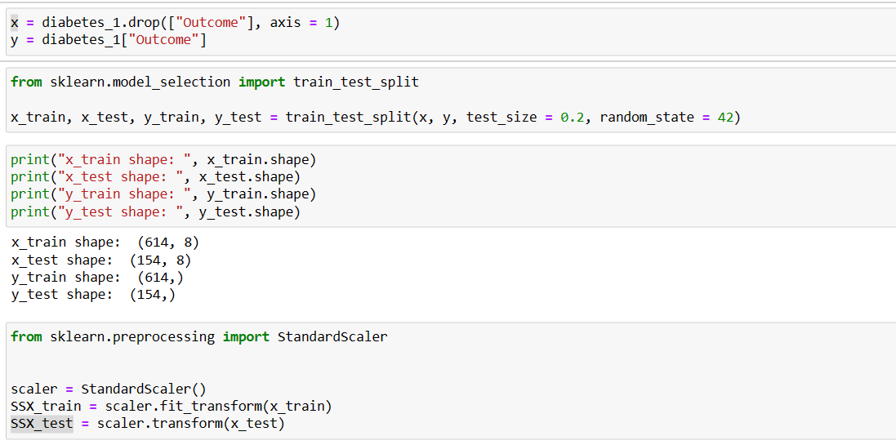
Data Splitting

Slide 12
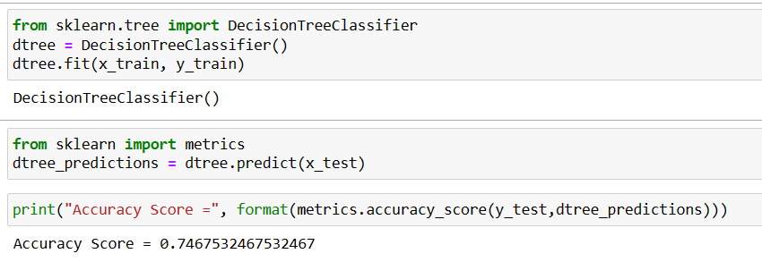
Decision Tree

Slide 13
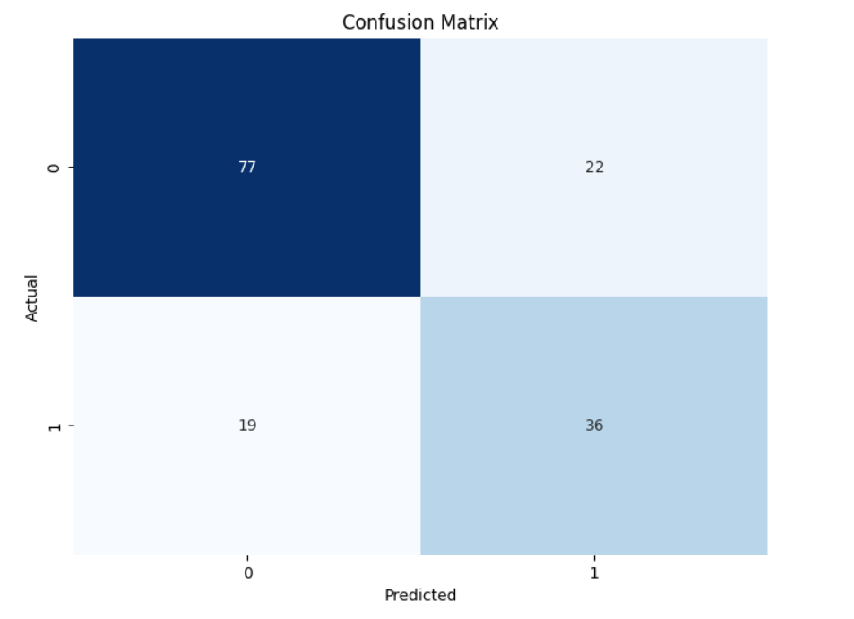
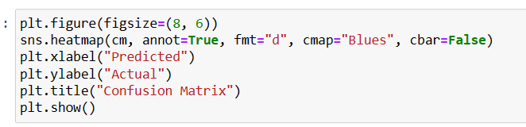
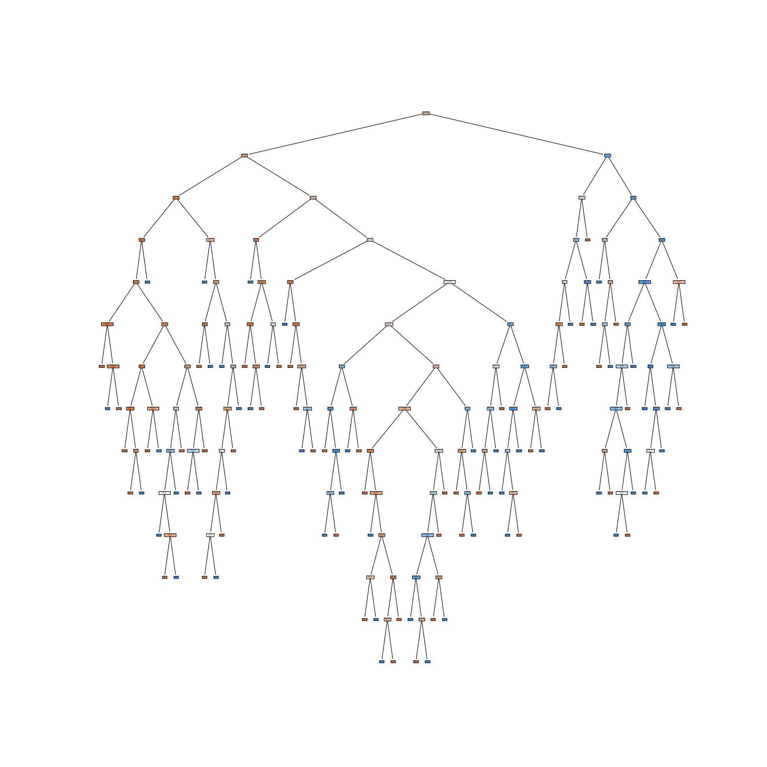
Confusion Matrix for Decision Tree

Slide 14
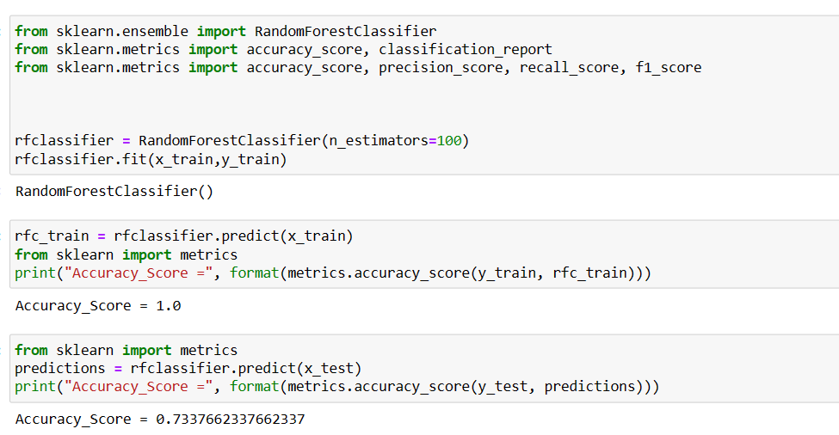
Random Forest

Slide 15
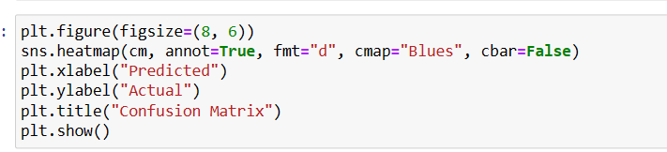
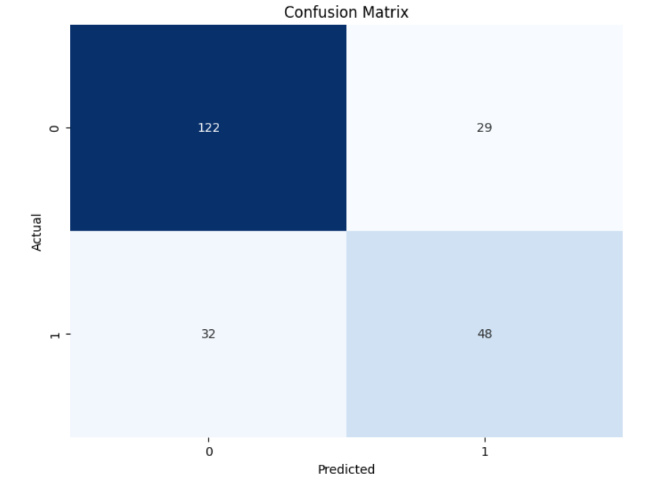
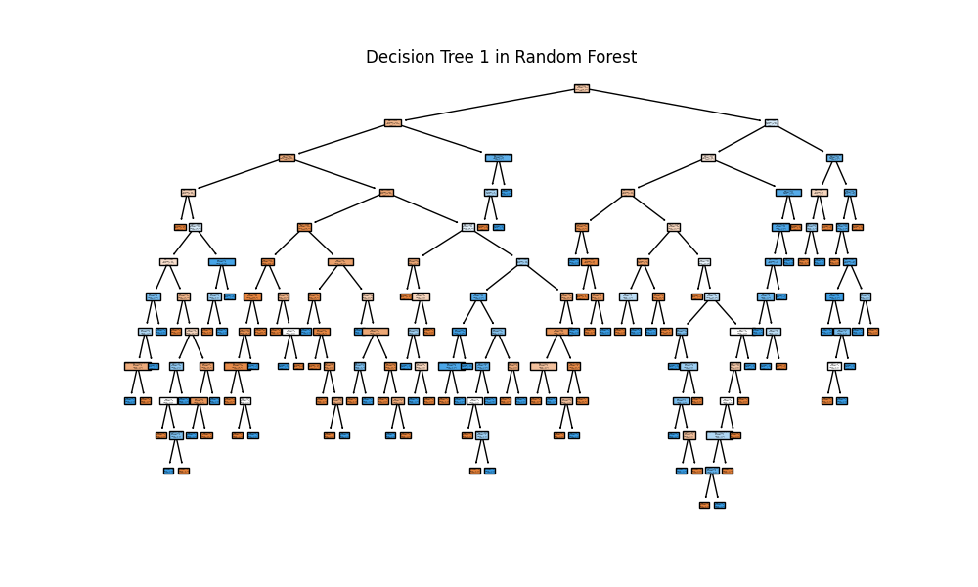
Confusion Matrix for Random Forest

Slide 16
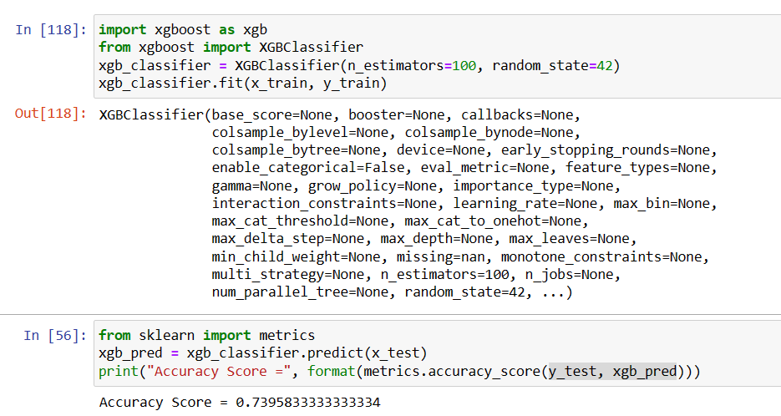
XG-Boost

Slide 17
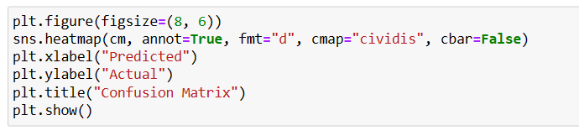
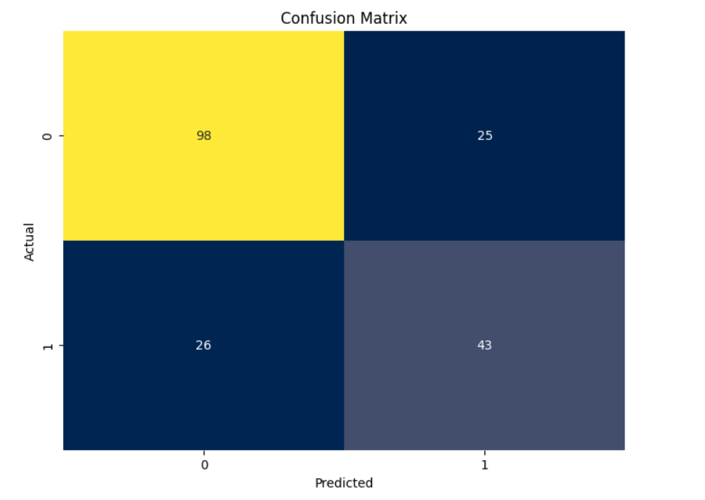
Confusion Matrix for XG-Boost

Slide 18
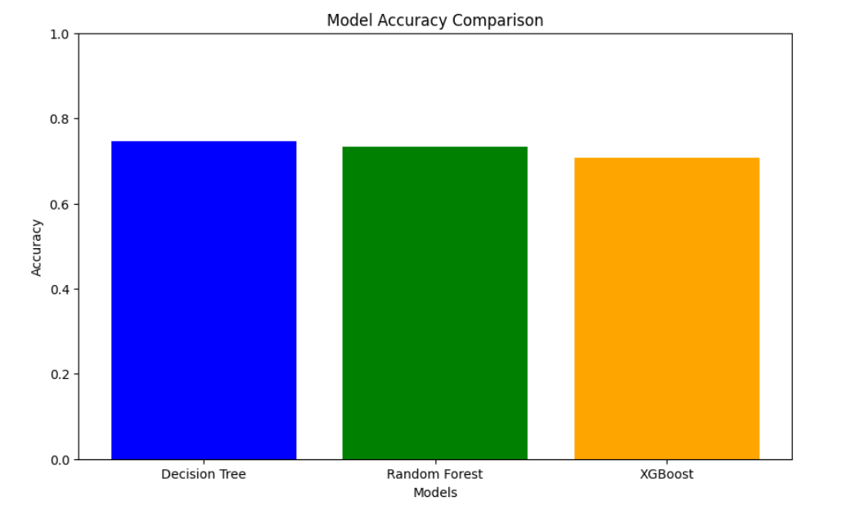
Comparing Between 3 Models

Slide 19
Result
 | Decision Trees | Random Forest | XGBoost
Accuracy Score | 0.7467532467532467 | 0.7337662337662337 | 0.7395833333333334

Slide 20
Discussion
We think we should use the results engendered by the random forest because we are dealing with relatively large dataset and that we want to enhance the effectiveness of the predictive model by avoiding overfitting. XGBoost can possibly be a more powerful algorithm, but it requires further fine tuning which is not performed in our analyses.
According to Mantelakis et al. (2021), the accuracy of 88% can be considered as good in clinical research. Further, a meta-analysis conducted by Olusanya et al. (2022) showed that the overall accuracy of using ML to diagnose type 2 diabetes is 86%. Thus, the current model with 71.88% accuracy may not be adequate to be useful in clinical setting to assist with diabetes diagnostics. However, our model does depict that elder people with high BMI and high blood glucose level are more likely to develop diabetes.

Slide 21
Reference
Olusanya, M. O., Ogunsakin, R. E., Ghai, M., & Adeleke, M. A. (2022). Accuracy of machine learning classification models for the prediction of type 2 diabetes mellitus: A systematic survey and meta-analysis approach. International Journal of Environmental Research and Public Health, 19(21), 14280. https://doi.org/10.3390/ijerph192114280
Mantelakis, A., Assael, Y., Sorooshian, P., & Khajuria, A. (2021). Machine learning demonstrates high accuracy for disease diagnosis and prognosis in plastic surgery. Plastic and Reconstructive Surgery - Global Open, 9(6). https://doi.org/10.1097/gox.0000000000003638

